Slide 1
Emergent Robustness in Software Systems through Decentralized Adaptation: an Ecologically-Inspired ALife Approach
Franck Fleurey, Benoit Baudry, Benoit Gauzens, André Elie, Kwaku Yeboah-Antwi
Notes:
Background
Motivation
Description of System
Partial Map of the Internet circa 2005

Slide 2
Internet Network
Notes:
Internet network is a constantly evolving and very unpredictable platform.
Links appear and disappear and nodes come and go
Software systems are built on top of it

Slide 3
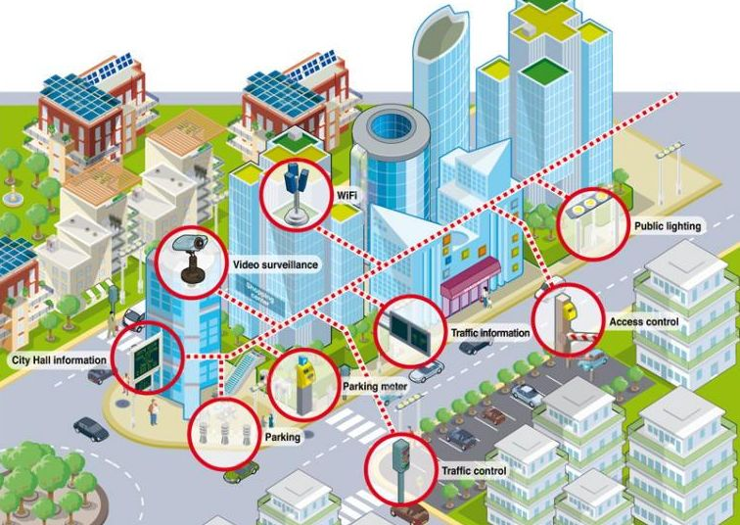
Loosely Couple Software Systems
Pollution
Providers provide services
Consumers rely on services
SmartGH
Waste
eHealth
C1
1,2
C2
1,3,4
C3
1,2,4
C4
2,3
P1 (cap=3)
1,2,3,
P2 (cap=3)
1,2,3,4
Notes:
Software Systems built as loosely coupled systems
Separation of components into separate entities
Links appear and disappear and nodes come and go evolving the systems
Have to deal with lots of uncertainty and unpredictability

Slide 4
Current Approaches
Approximate redundancy
Waste of resources, overkill or not enough
Centralized management techniques
Requires global knowledge of system
Notes:
To deal with this uncertainty, we have these measures
*Google for example monitors everything
Software systems cannot evolve and adapt in response to the changing environments.
Why must we adapt?

Slide 5
Why must we adapt?
“Now, here, you see, it takes all the running you can do, to keep in the same place.”
- Red Queen (Alice in Wonderland)
Notes:
Lee van Halen coined “Red queen hypothesis”, evolutionary hypothesis that organisms must constantly evolve and adapt not only to gainreporductive advantage but also to simply survive in an ever-changing envronment.
The different layers evolve separately leading to lots of miscommunications
Leads to lots of downtime
Lots of unavailability
Faulty systems
We adapt the red queen hyporthesis to software systems.

Slide 6
Hypothesis
Localized adaptation results can result in increased robustness

Slide 7
Modeling Software Systems
“Computer systems can be better understood, controlled, and developed when viewed from the perspective of living systems”
- Forrest et al. “Computation in the Wild” (2002)¹
1. Forrest, Stephanie, et al. "Computation in the Wild" Robust Design: A Repertoire of Biological, Ecological, and Engineering Case Studies (2002): 207-230. Reprinted in The Internet as a Large-Scale Complex System (2005): 227-250
Notes:
Add link

Slide 8
Our Approach
Model software systems in an ALife simulator
Model evolution and adaptation
Test different adaptation strategies
Analyze these strategies and evaluate their ability to deal with uncertainty and increase robustness of the software systems

Slide 9
EvoServ
ALife model and simulator of loosely coupled software systems
Providers and Consumers as individuals
Model adaptation and evolution of providers and consumers
Platform for analysis of different adaptation and evolution strategies

Slide 10
Software System Model
Components and their interactions are modeled using bipartite graph model
Bipartite graph model used to simulate evolution of the providers and consumers

Slide 11
Bipartite Graph Model
Notes:
Merge this and next

Slide 12
Adaptation vs. Evolution
Adaptation
Changes to the individual nodes in the system
The composition of the set of nodes in the network does not vary
Evolution
Changes which vary the composition of the system
The composition of the set of nodes in the network does vary
Notes:
Providers and consumers can appear and disappear over time

Slide 13
Experimental Protocol
For each cycle, we run adaptation and/or evolution strategies
EvoServ is run for X cycles
Evaluate robustness of graph
Notes:
We want to prevent having scarcity as a confounding bias in order to isolate effect of adaptation rules
Number of services and links must remain constant after the simulation is started

Slide 14
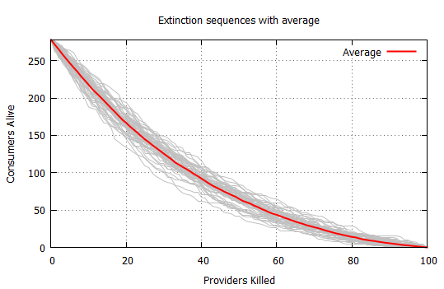
Robustness
Robustness: The ability of the consumers to resist extinction of providers
32,24%
area_under_curve
Σ(consumers) x Σ(providers)

Slide 15
Robustness
Robustness: The ability of the consumers to resist extinction of providers
C1
1,2
C2
1,3,4
C3
1,2,4
C4
2,3
P1 (cap=3)
1,2,3,
P2 (cap=3)
1,2,3,4
Notes:
We need to fix our initial model of a software system so that we can analyze adaptation and evolution in it

Slide 16
Tuning EvoServ
Collect and analyze data from real-world software systems
WordPress¹
Web Browsers²
Use results and information abstracted to tune service availability and distribution in EvoServ
http://diversify-project.eu/wordpress/
http://amiunique.org/
Notes:
1/5 (110,000 of 500,000) top websites on internet use wordpress (ranked by alexa). We scrape data about plugin usage on them
We set up https://amiunique.org/, a website where we collect anonymous information about the browser, the list of fonts and plugins it contains from every visitor. 63,000
Similar probability distribution in data
Number of plugins per entity follows poisson distribution
Rate of plugin usage per plugin follows negative exponential slope

Slide 17
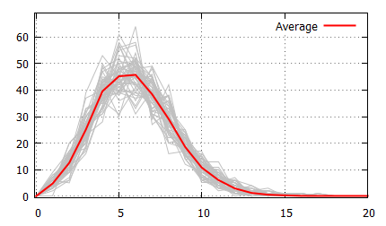
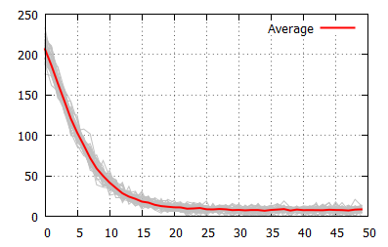
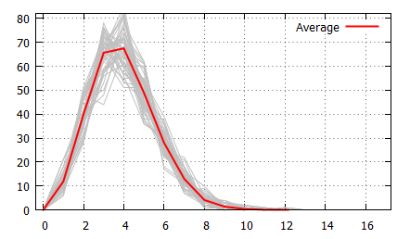
EvoServ Model Parameters
Service usage
Consumer sizes
# Number of providers 100
# Number of consumers 300
# Number of services 50
# Consumer Capacity 100
# Provider Capacity 18
# Minimum application size 1
# Dist. of consumer size Poisson (lambda=6.0)
# Dist. of provider size Poisson (lambda=6.0)
# Dist. of services usage Combined (lambda=0.25, uniform factor=0.005)
# Number generated graphs 50
Links / Consumer
Notes:
*Numbers of providers and consumers based on a cloud service brokerage example
*We determined that after 50 initial different simulations, variance for results was below 0.01
providers = Platforms *consumers = Applications
Top left = distribution of how many services were required (x is count and y = number of times required) 0 services were required 200 times, 5 services were required 100 times
Top right = distribution of consumer sizes (x = count and y = services required) 5 consumers required 45 services
Botton right = Links per consumer (x = links made, y = number of consumers that made x links)

Slide 18
Adaptation in EvoServ
Consumers
Varying the set of links/connections
Providers
Varying the set of services provided
Provision of consumer dependencies guaranteed

Slide 19
Provider Adaptation Strategies
Adaptation = Changing set of services offered
Relies on the set of consumers connected to the provider
Notes:
Total number of Services remain constant to maintain

Slide 20
Random Adaptation Strategy [Provider]
Provider P stochastically chooses to either
Provide a new service xxx
OR
Drop a service it provides

Slide 21
Popular Adaptation Strategy [Provider]
Service Popularity
S0 : 2
S1 : 1
S2 : 2
S3 : 0
S4 : 1
{1, 2}
{0, 1, 2, 3}
{1, 2, 3, 4}
Valid adaptations:
Notes:
Add a popular services or remove unpopular service
Popularity = Frequency of usage among consumers served by P (P can access the set of services required by its consumers)
Probability of a service being chosen is proportional to its popularity(when adding) or unpopularity(when dropping)
CAVEAT: Dropping a service should not lead to a consumer going extinct.
Probability of choosing to drop a service is proportionally to the number of consumers being served

Slide 22
Consumer Adaptation Strategies
Adaptation = Changing set of links to providers
Keep at least one source for each required service
Relies on a neighbourhood of providers only
Notes:
Selection from neighbourhood
Neighbourhood: a randomly picked subset of providers from the set of all of providers
We do the selection this way in lieu of implementing one of the many Platform and Service advertisement/discovery mechanisms that exist.
All strategies constrained such that, all required services that were provided still remain provided after adaptation

Slide 23
Random Adaptation Strategy [Consumer]
Consumer C chooses to link to
A new randomly chosen provider P

Slide 24
Equitable Adaptation Strategy [Consumer]
Frequency
A1 {0, 1, 2, 3}
Equitability
{P0, P2}
{P0, P2, P3}
{P0, P3}
[2, 2, 1, 1]
[2, 3, 2, 2]
[1, 2, 2, 2]
0.95
0.98
0.97
Valid adaptations:
Neighbourhood
Notes:
Link to the set of providers whose services favors the equitability of services obtained
Equitability = the number of times each required service is provided (taken from biodiversity)

Slide 25
Evolution in EvoServ
Evolution rules:
Birth, Death, Crossover and Mutation
Satisfaction of consumer dependencies not considered
Notes:
Changes which vary the composition of the system(ie. providers and consumers can appear and disappear over time)

Slide 26
Evolution Strategies [Providers]
New providers can be generated by
Extinction (Probability: 30%)
Cloning (Probability: 30%)
Reproduction (Probability: 30%)
New providers can be generated by
Cloning an existing provider and mutating its services

Slide 27
Evolution Strategies [Providers]
New providers can be generated by cloning an existing provider and mutating its services* stochastically
Random Evolution Strategy:
Service Mutation Probability : 20%
Ecological Evolution Strategy:
Service Mutation Probability : Inversely proportional to popularity of service among linked consumers
*Service Mutation : Add or remove a service
Notes:
*Ecological: Analogous to envrinomental pressure in nature

Slide 28
Evolution Strategies [Consumer]
Consumers can undergo
Extinction (Probability: 30%)
Cloning (Probability: 30%)
Reproduction (Probability: 30%)
New consumers can also be generated by
Crossover (combining subsets of services from the two parents)
Notes:
Crossover uniform

Slide 29
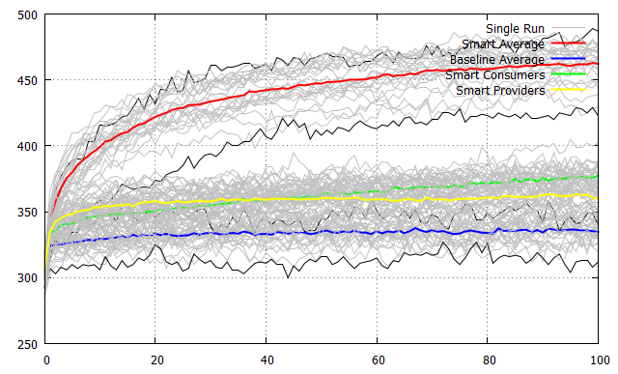
Experimental Results
Strategies
Consumer Provider Avg
Random Random 33.4%
Random Popular 35.9%
Equitable Random 37.7%
Equitable Popular 46.2%
Notes:
Can local adaptation lead to the emergence of global robustness in software systems?
Robustness from localized strategies better. Explain each line (X: adaptation steps y : unnormalized robustness index )
2. How sensitive are the adaptation rules when relaxing topological constraints of the software system?
Allow evolution. Similar results
3. How does the distribution of services among consumers influence the results?
Localized adaptation still does better.
4. What is the effect of the system’s scale?

Slide 30
Conclusions
Localized adaptation strategies
Better than a random baseline
Contributes to global robustness
Robust to parameters of the graph
Robust to evolution
No need for coordination or centralization
Equitable / Popular local adaptation strategy
Combining localized adaptation strategies in both layers best strategy
Notes:
Tested a range of other (more complicated) strategies which did not provide any significant improvement

Slide 31
Conclusions
Is robustness an emergent property of adaptation in software systems?
YES
Notes:
Strategies based on local information and acting locally allow a system to get to a state of global robustness

Slide 32
Conclusions
EvoServ* is realistic platform for modeling software systems
Useful for testing other adaptation and evolution strategies on software systems
https://github.com/DIVERSIFY-project/EVOSERV

Slide 33
Thank You Questions, Comments or Suggestions?

